Slide 1



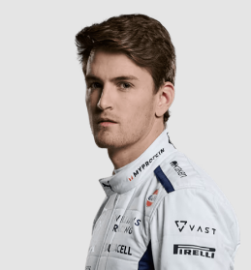
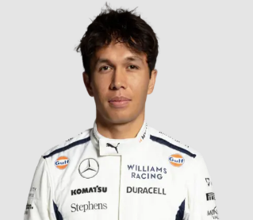

UBS
BAHRAIN
Formula 1 BAHRAIN GRAND PRIX
GRAND PRIX
Williams Grand Prix Engineering Limited
MSDM5005 Group 4
Sakheer الصخير‎
2 MARCH 2024

Slide 2
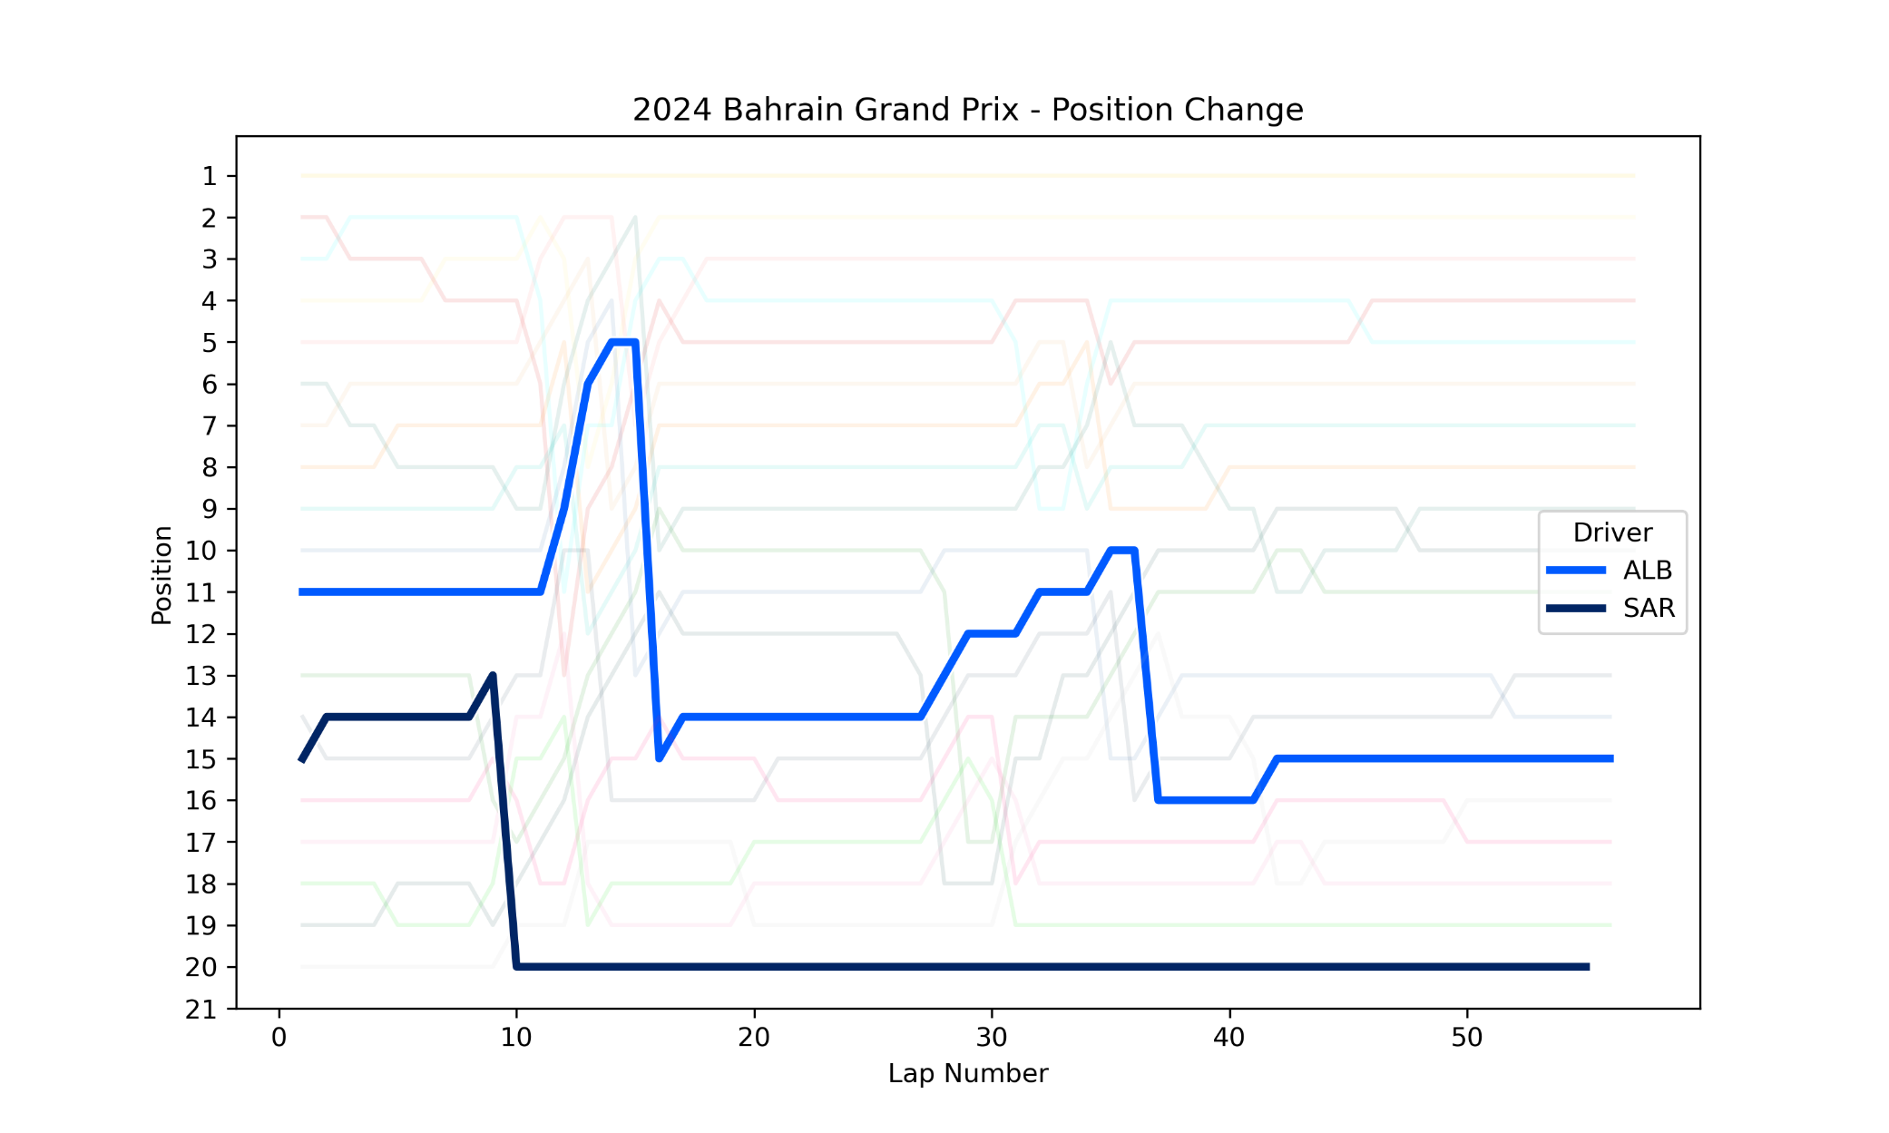
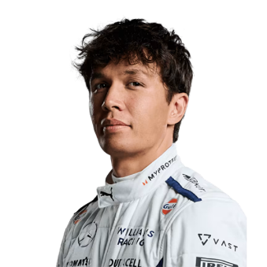
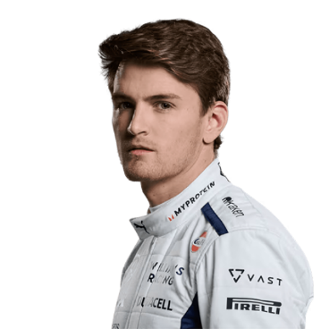
UBS
Player Performance
BAHRAIN
GRAND PRIX
ranking list
2 MARCH 2024
Alexander Albon
Qualifying Ranking: 13
Race Ranking: 15
56 Laps, + 1 lap
Logan Sargeant
Qualifying Ranking: 18
Race Ranking: 20
55 Laps, + 2 lap

Slide 3
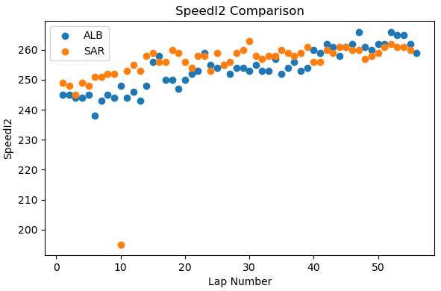
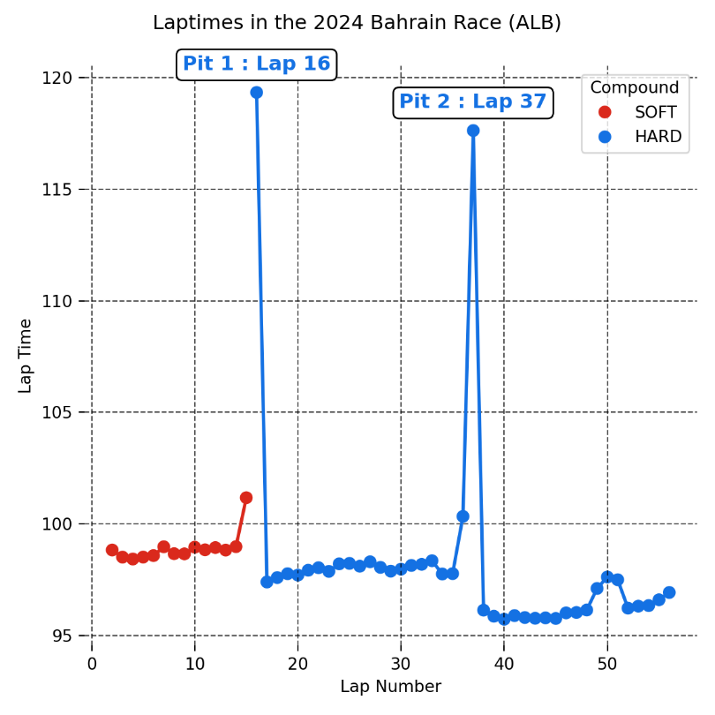
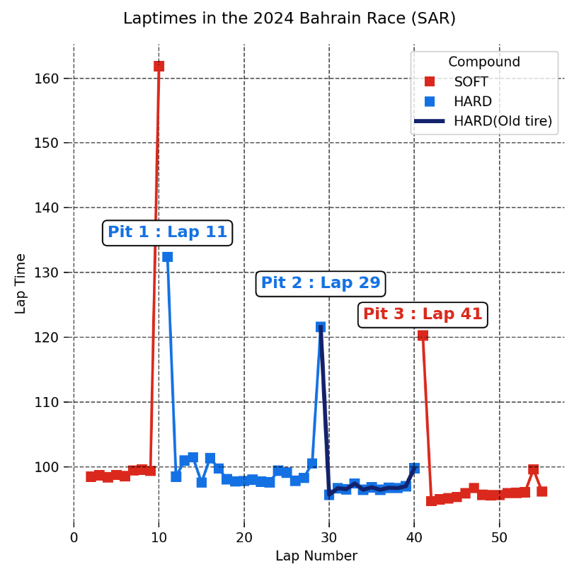
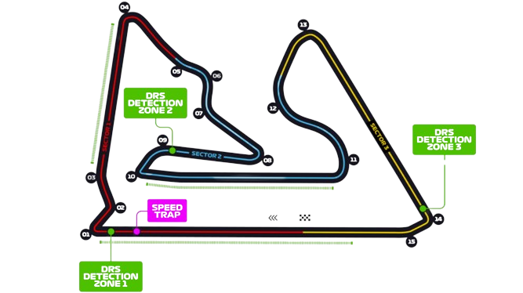









UBS
Player Performance
BAHRAIN
GRAND PRIX
Tire strategy
2 MARCH 2024
Old tire

Slide 4
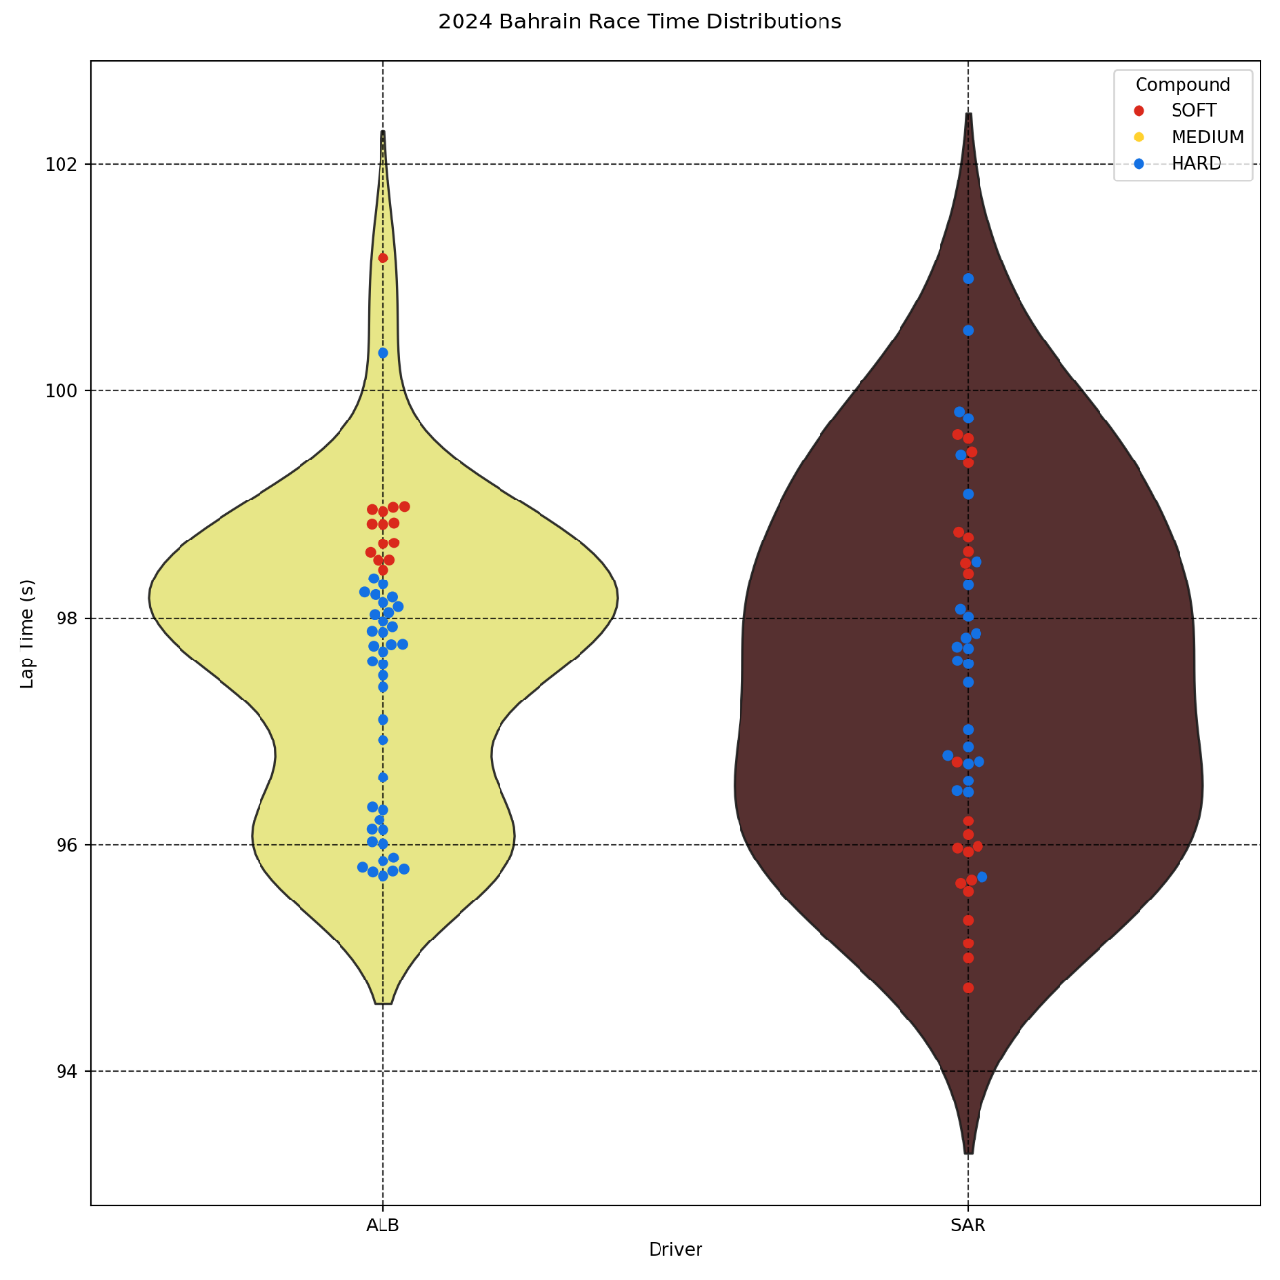
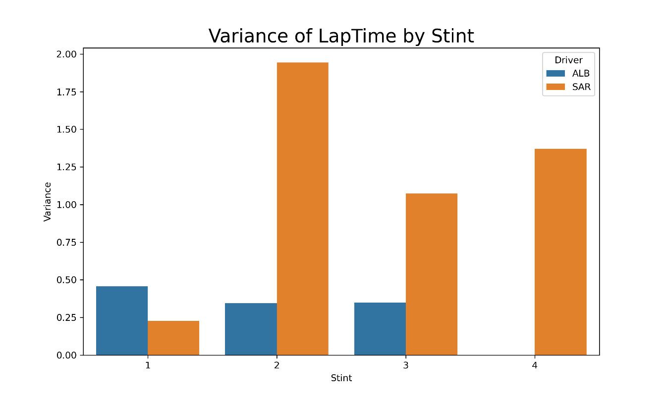
UBS
Player Performance
BAHRAIN
GRAND PRIX
STABILITY comparison
2 MARCH 2024
Albon keeps high stability in all three stints
Sargeant is unstable in the latter three stints, especially the second stint

Slide 5
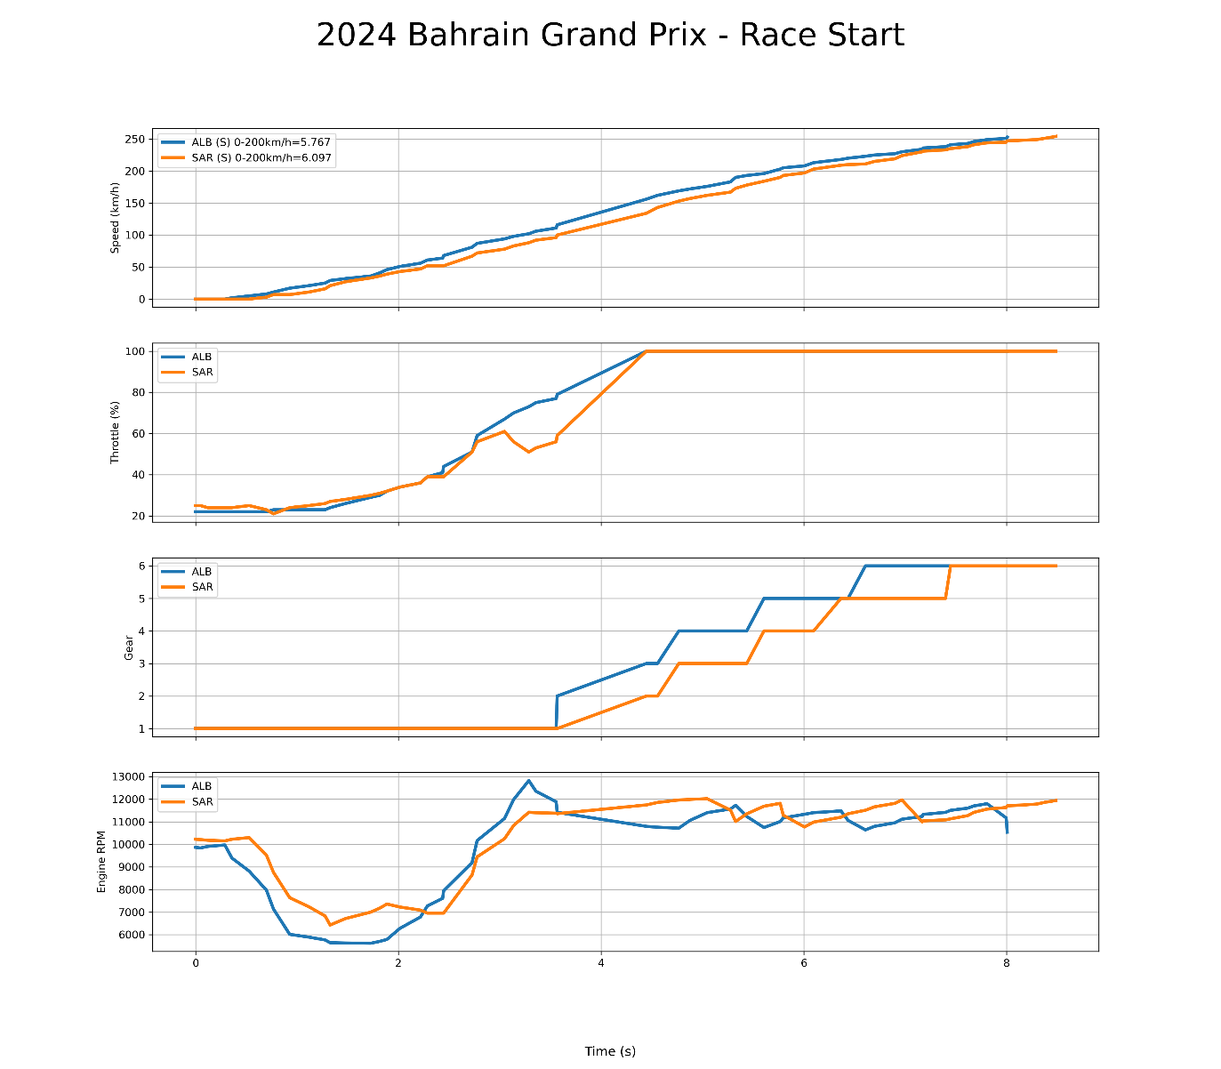
UBS
Player Performance
BAHRAIN
GRAND PRIX
Driving tech & strategy comparison
2 MARCH 2024

Slide 6
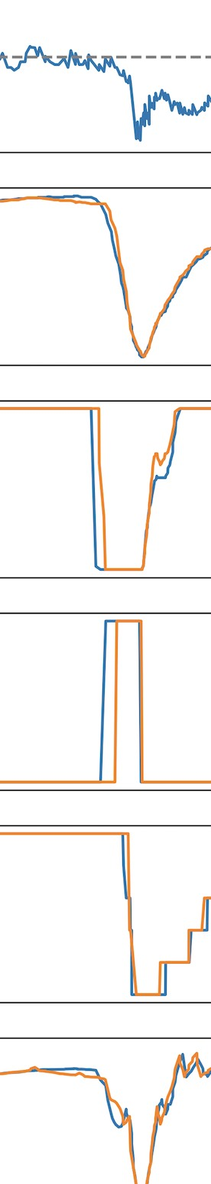
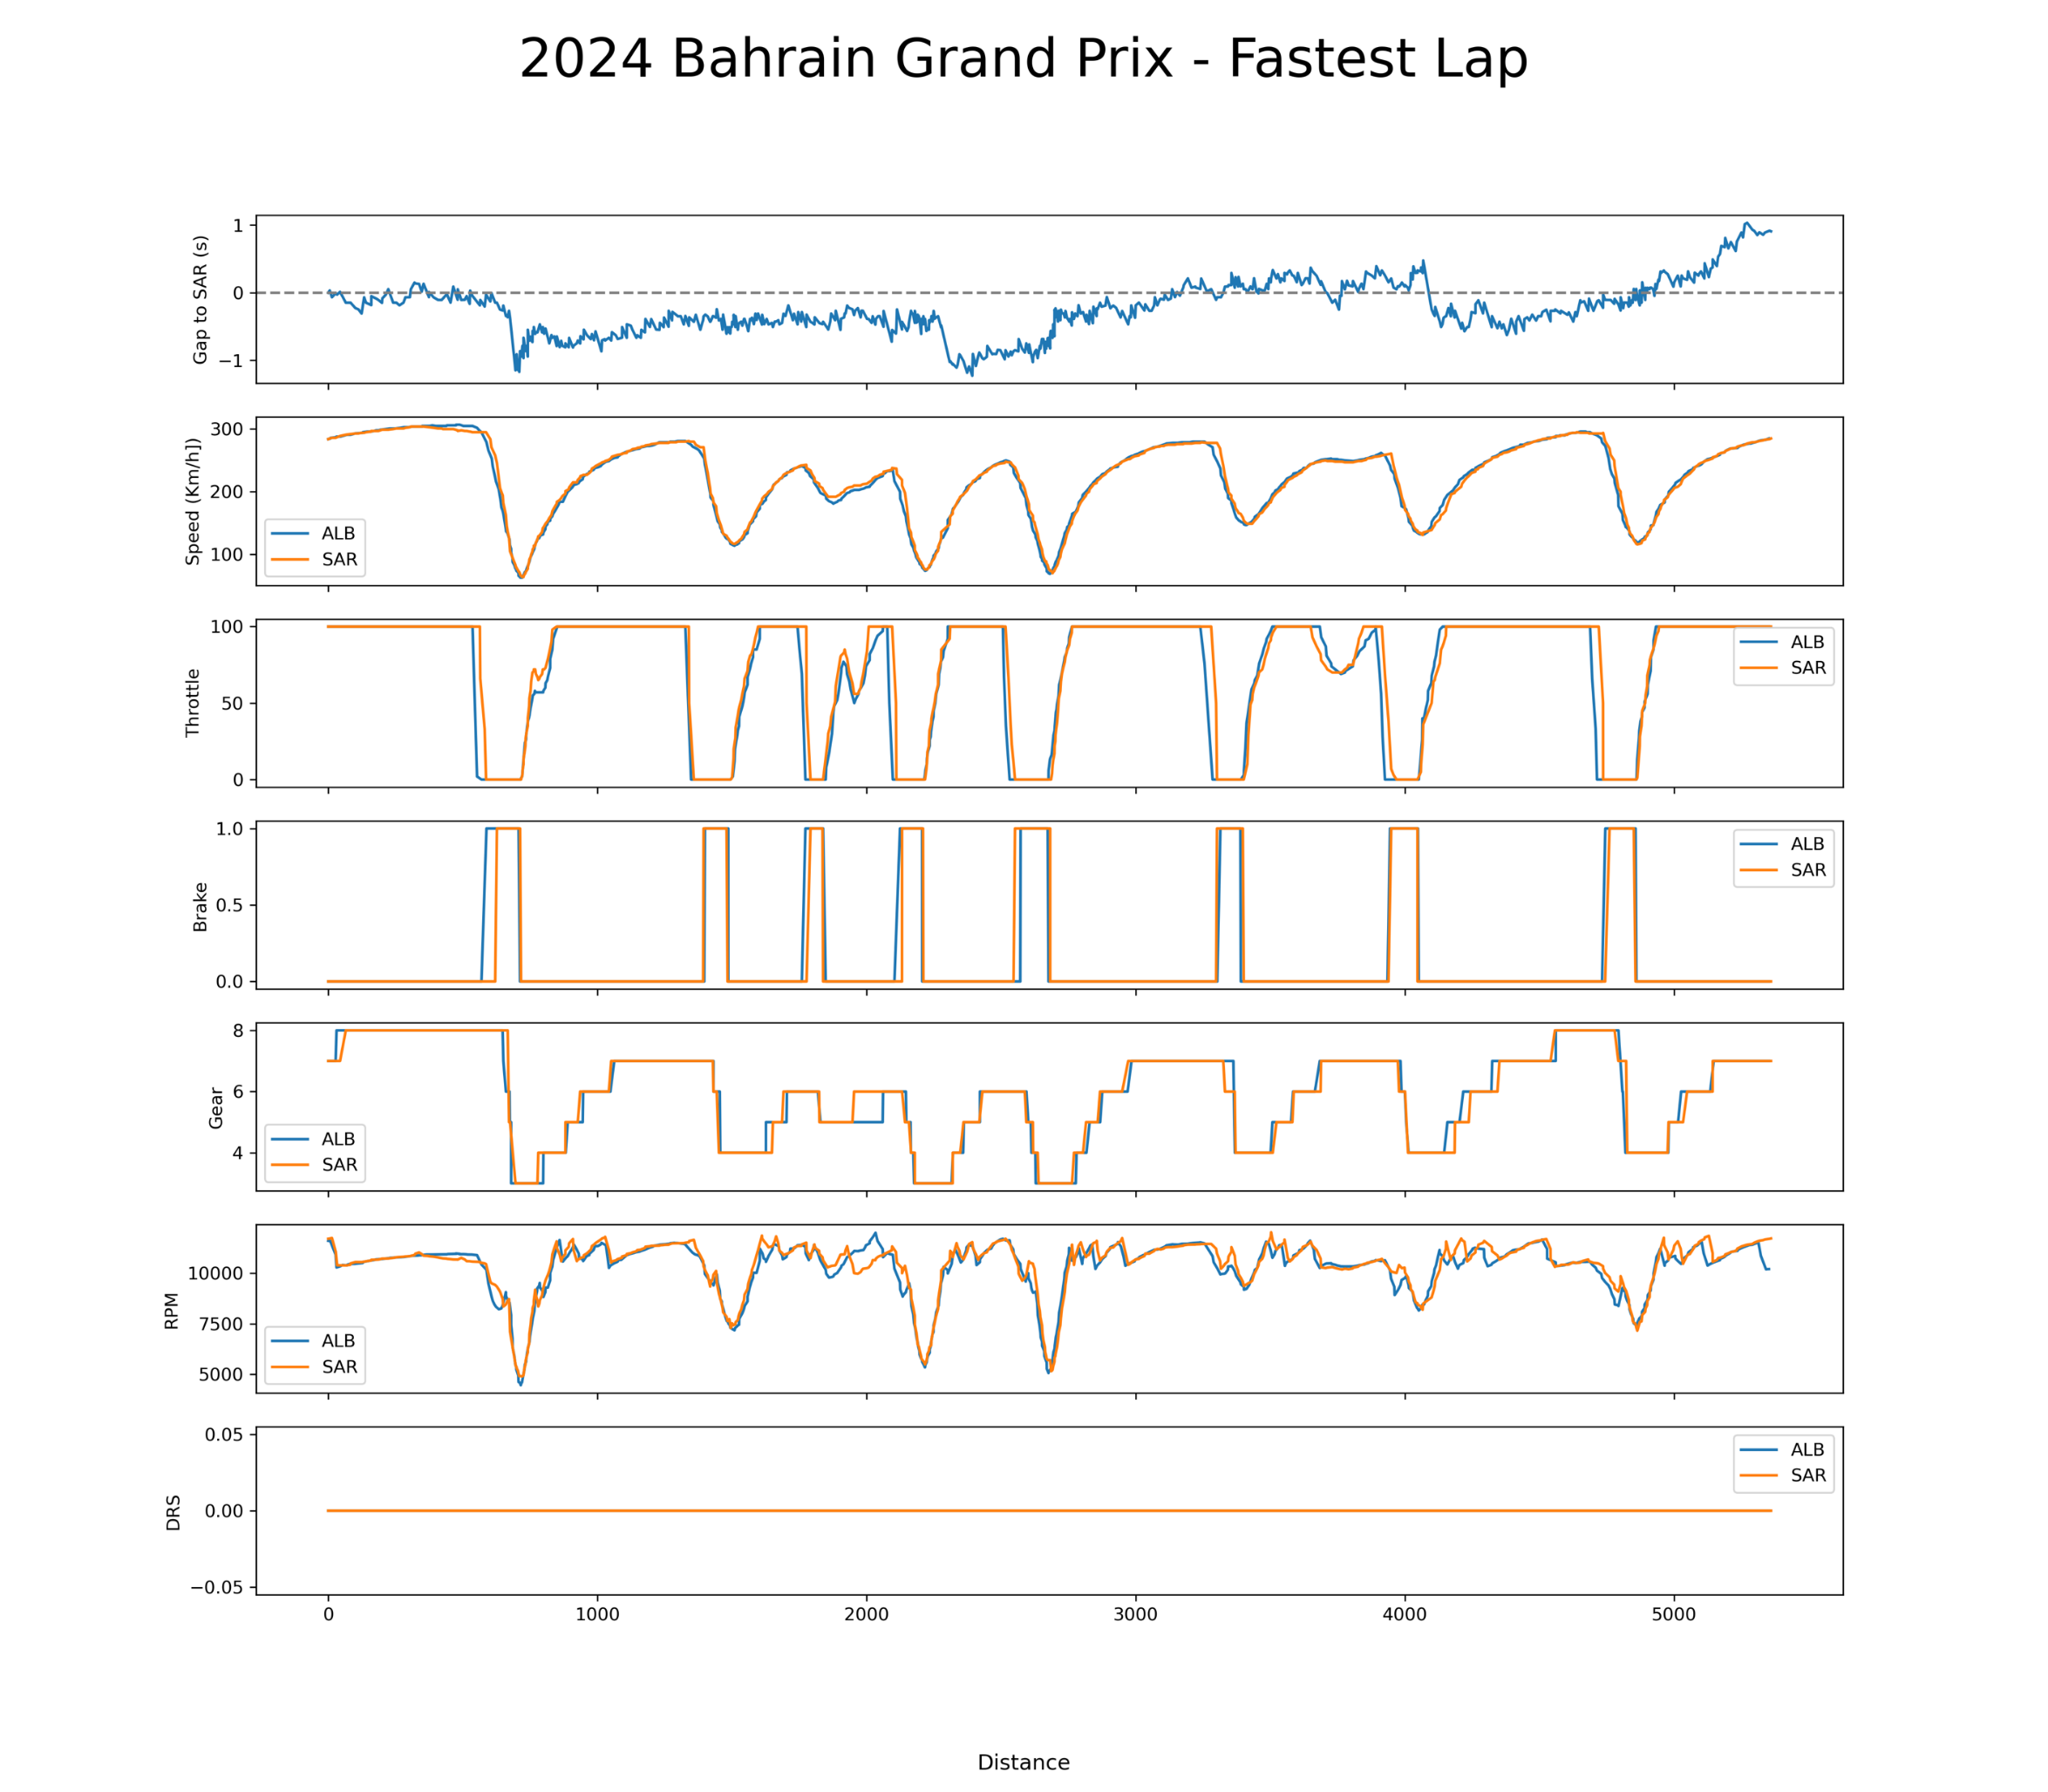
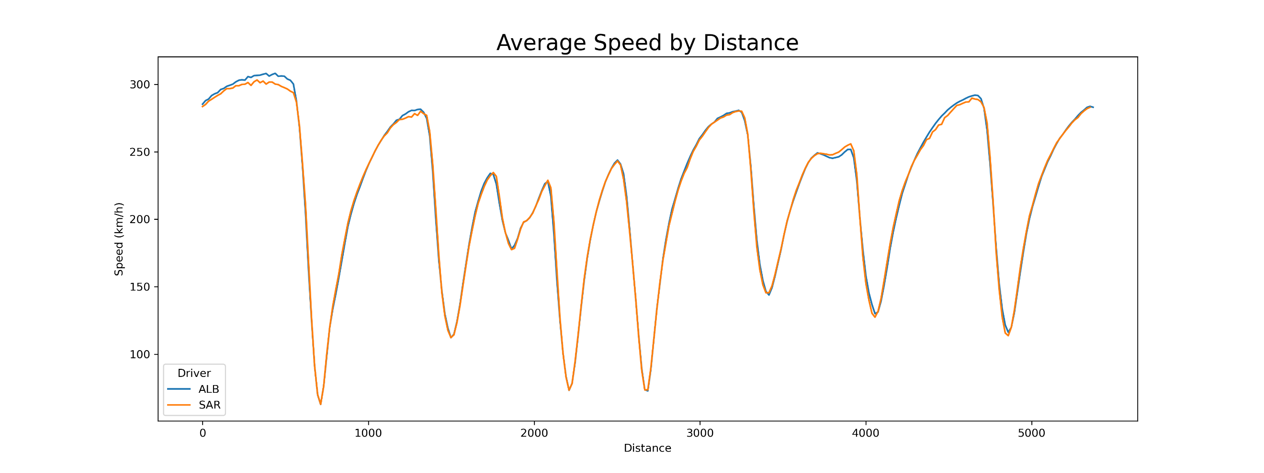
UBS
Player Performance
BAHRAIN
GRAND PRIX
Gap to SAR
CORNER performance
2 MARCH 2024
Speed
Throttle
Brake
Gear
RPM

Slide 7
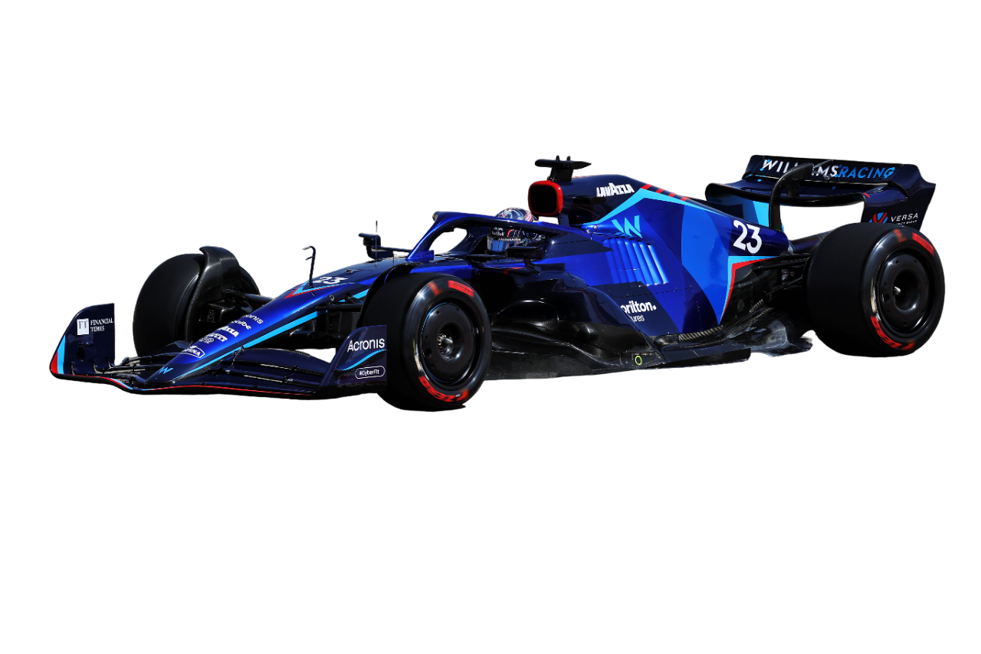
THANKS FOR LISTENING
UBS
BAHRAIN
GRAND PRIX
Sakheer الصخير‎
MSDM 5005 Group 4
2 MARCH 2024

